Slide 1
Exploratory Data Analysis Report.
HNG Slack-ID -ACSP
Jupyter Notebook

Slide 2
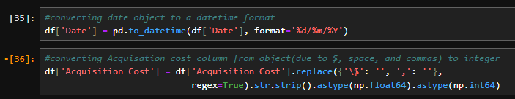
 | Campaign_ID | Conversion_Rate | ROI | Clicks | Impressions | Engagement_Score
count | 200005 | 200005 | 200005 | 200005. | 200005 | 200005
mean | 100003 | 0.080069 | 5.002416 | 549.774591 | 5507.307107 | 5.494673
std | 57736.614632 | 0.040602 | 1.734485 | 260.019354 | 2596.863794 | 2.872593
min | 1 | 0.010000 | 2.000000 | 100 | 1000 | 1
25% | 50002 | 0.050000 | 3.500000 | 325 | 3266 | 3
50% | 100003 | 0.080000 | 5.010000 | 550 | 5518 | 5
75% | 150004 | 0.120000 | 6.510000 | 775 | 7753 | 8
max | 200005 | 0.150000 | 8.000000 | 1000 | 10000 | 10
INTRODUCTION
Marketing campaign dataset has 200005 rows and 15 columns.
The data type comprises of two float64, four int64, and nine object.
The statistical component of the numerical column are listed in the table at the left.
The only data quality issues found is invalid data types
Date and acquisition cost were stored as object.
Date is thus converted to datetime data type
Acquisition cost is converted to integer.
The code used is given below the table.

Slide 3
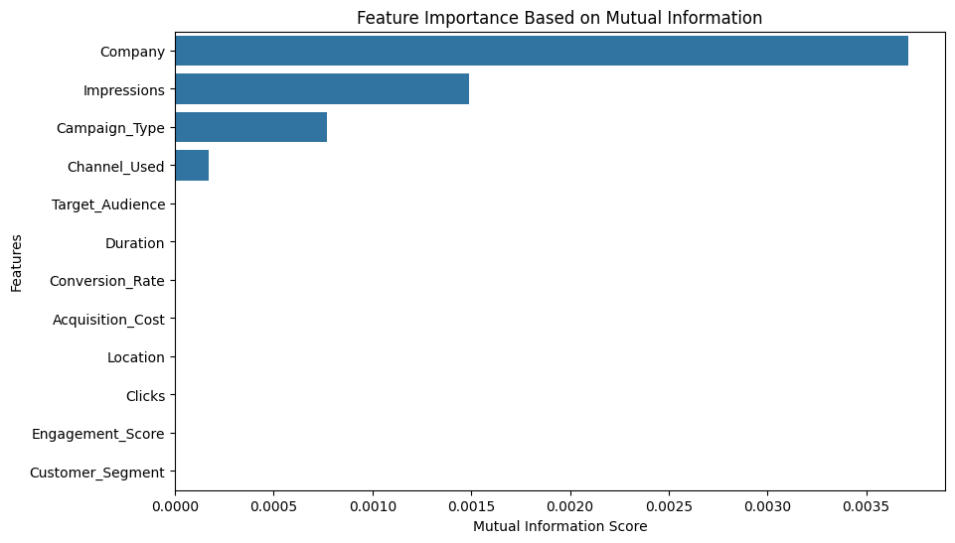
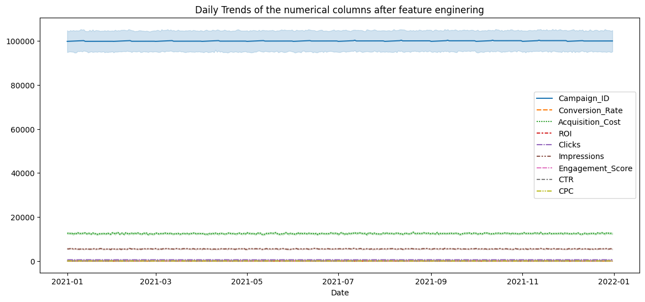
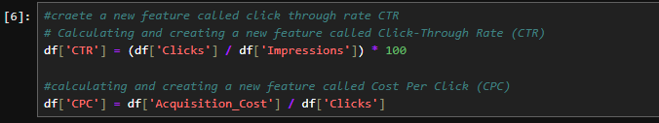
FEATURE ENGINEERING
Mutual Information (MI) scores measure the dependency between each feature and the target variable (ROI).
Company (0.003753), Impressions (0.001491), Channel_Used (0.000170) and Campaign_Type (0.000770) have a weak overall influence on ROI.
All the features may be useful in interaction terms with other variables.
From the MI findings, it becomes important for some next steps such as feature engineering
The code below was used to create two new columns, Click-Through Rate (CTR) and Cost Per Click (CPC).
CTR and CPC are included in the dataset as seen in the line plot.
Notes:
The mutual information(MI) is a general purpose metric that detect any kind of relationship between two quantities. MI is a measure of the extent to which knowledge of one quantity reduces uncertainty about the other.
Although there isn’t a fixed range but MI tends to range from 0 to 2. Feature with a high MI score have better interaction with the target variable, which in this case was set to ROI

Slide 4
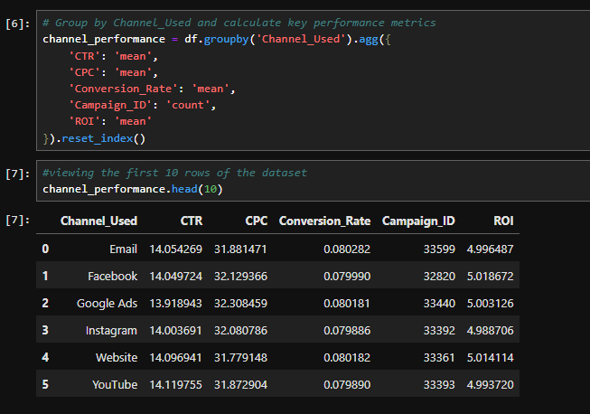
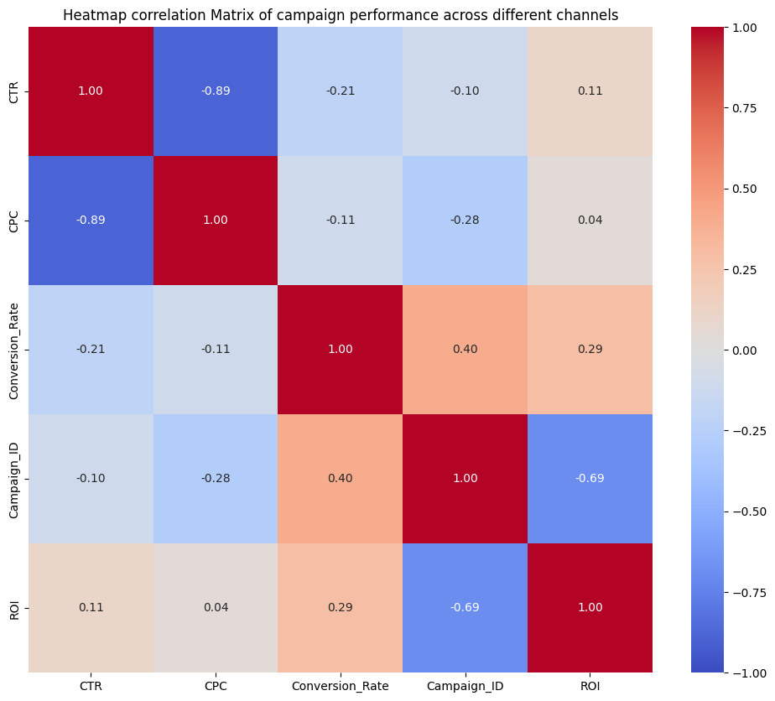
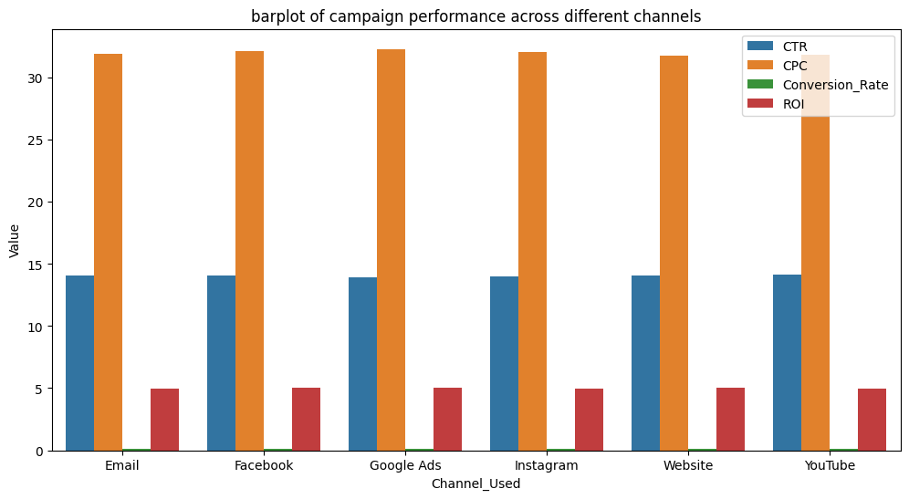
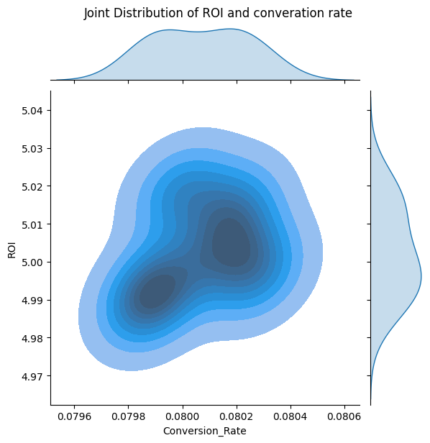
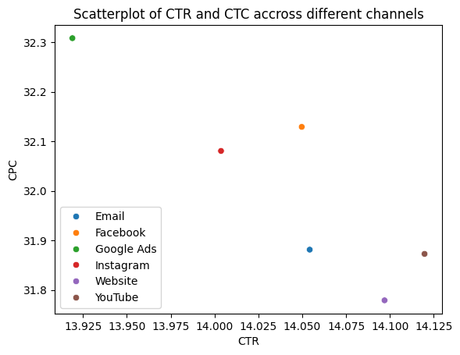
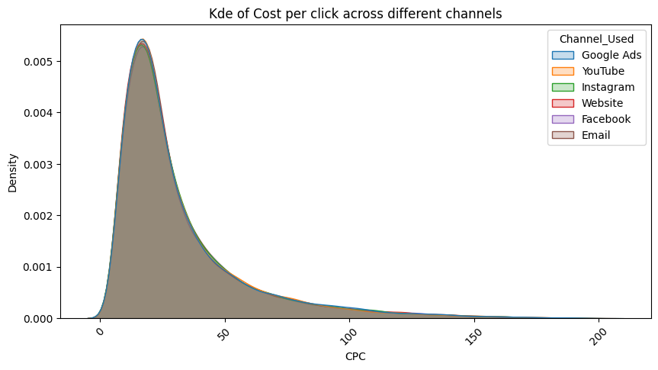
INSIGHT GENERATION
Key findings from the campaign performance across different channels includes:
Click-Through Rate (CTR) Trends: CTR variations are minimal (~0.2%), meaning all channels drive relatively similar engagement rates.
Cost-Per-Click (CPC) Insights: Google Ads is 1.67% more expensive than Website in terms of CPC, indicating higher ad costs but not necessarily better returns.
Conversion Rate Performance: Instagram has the lowest conversion rate (7.99%), which may indicate a weaker intent-to-purchase audience.
Campaign Count Distribution: All channels are relatively balanced (33K campaigns each), meaning no major bias in ad spend distribution.
Return on Investment (ROI): ROI mean differences are small (range: 4.988 – 5.019), suggesting all channels have a similar profitability margin with no drastic outliers
Notes:
The mutual information(MI) is a general purpose metric that detect any kind of relationship between two quantities. MI is a measure of the extent to which knowledge of one quantity reduces uncertainty about the other.
Although there isn’t a fixed range but MI tends to range from 0 to 2. Feature with a high MI score have better interaction with the target variable, which in this case was set to ROI

Slide 5
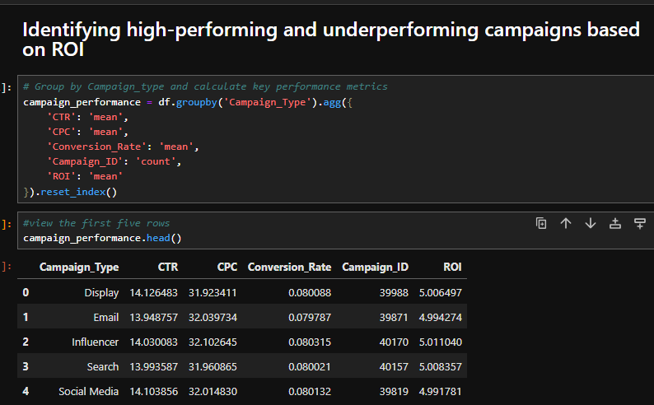
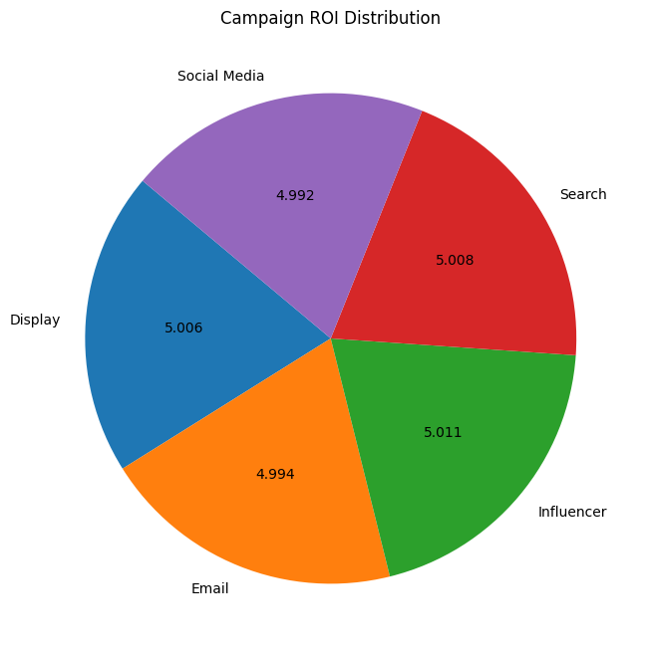
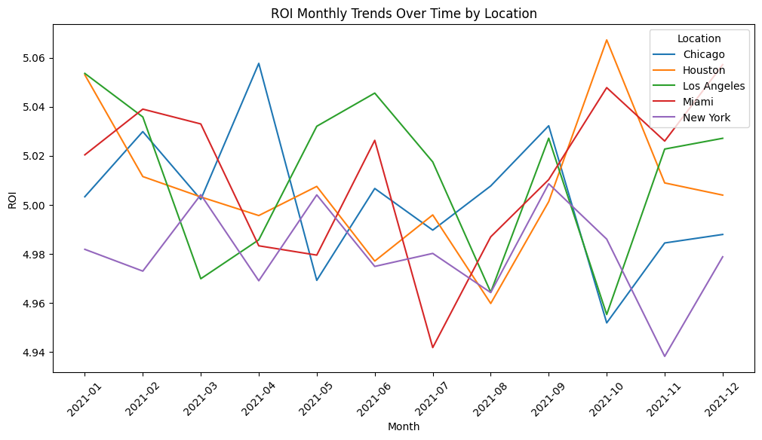
INSIGHT GENERATION - contd
Based on ROI and Campaign type, the high performing campaigns are;
Top Performer: Influencer Marketing (ROI = 5.011), and
Search Ads (ROI = 5.008)
Underperforming Campaigns Based on ROI and campaign type are:
Lowest ROI: Social Media Ads (ROI = 4.991)
Email Campaigns (ROI = 4.994)
The findings of the line chart below of the location monthly trends by ROI are;
Houston and Miami, exhibit sharp peaks, indicating seasonal trends or region-specific promotions.
Chicago and New York display relatively stable trends, indicating a more consistent audience engagement.
Los Angeles show notable volatility reflecting responsiveness to different campaign types
Notes:
The mutual information(MI) is a general purpose metric that detect any kind of relationship between two quantities. MI is a measure of the extent to which knowledge of one quantity reduces uncertainty about the other.
Although there isn’t a fixed range but MI tends to range from 0 to 2. Feature with a high MI score have better interaction with the target variable, which in this case was set to ROI

Slide 6
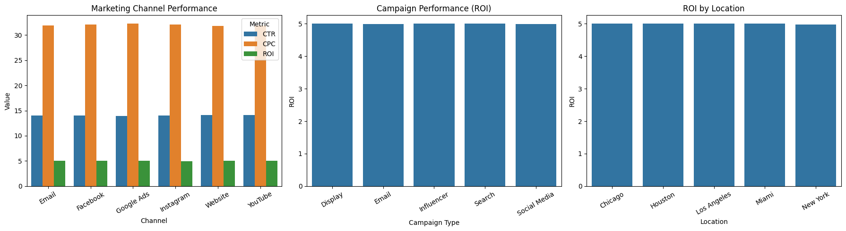
Conclusion and Recommendations
Channels:
Facebook is a solid performer and you should maintain ad budget allocation.
Google Ads is the most expensive platform (highest CPC) but doesn't lead in CTR or ROI. Consider optimizing ad spend to improve efficiency
Allocate more budget to Website Ads (best CTR + lowest CPC)
Re-evaluate Instagram targeting strategies, consider retargeting campaigns or better ad creatives.
Campaign:
Increase investment in Influencer and Search campaigns since they provide strong returns on investment.
Location:
Chicago, New York are ideal for long-term branding efforts due to their ROI stability.
Houston, Miami may benefit from short-term aggressive marketing tactics, such as seasonal promotions due to their spikes in ROI
max growth

